Slide 1
What is Spark Streaming
Framework for large scale stream processing
Scales to 1000 of nodes
Latencies in the scale of seconds
Integrates with Spark’s batch and interactive processing
Provides a simple batch-like API for implementing complex algorithm
Can absorb live data streams from various sources like Kafka, Flume
Inspiration
Many applications benefit from acting on data as soon as it arrives and provide results in near-real-time
Social network trends
Website statistics
Why Spark Streaming
Scalable
Latency
Simple programming model
Integrated with batch & interactive processing
Efficient fault-tolerance

Slide 2
Spark Streaming
Data is received as a stream
RDD is collection of entities – rows, records
An RDD is similar to a collection object in java which can be assigned to a variable and different methods can be used to return a value or another RDD.
Spark streaming works on Discretized Streams(DStream)
DStream is nothing but sequence or groups of RDDs
Every stream is formed based on an interval called as batch interval, All data received within the batch interval makes an RDD.
Within a DStream, spark still performs operations on individual RDDs, operations of DStream returns another DStream.
Fault tolerance is handled by checkpointing.
Streaming applications requires additional features to protect against data loss.
Checkpointing periodically saves data to a reliable storage system (HDFS/S3) for fault tolerance, By checkpointing, It limits the RDD operations to re-compute from scratch in case of failures.

Slide 3
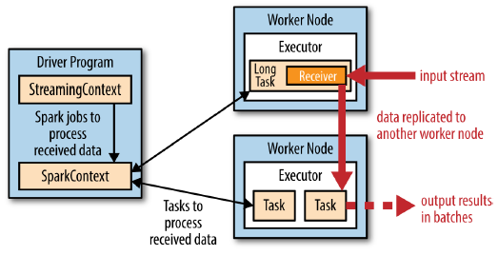
Architecture
Input Dstreams
Input DStreams are DStreams representing the stream of input data received from streaming sources.
Categories of built-in streaming sources.
Basic sources: Sources directly available in the StreamingContext API. Examples: file systems, and socket connections.
Advanced sources: Sources like Kafka, Flume, Kinesis, etc. are available through extra utility classes. These require linking against extra .
Receivers
Every input DStream is associated with a Receiver which receives the data from a source and stores it in Spark’s memory for processing.
To receive multiple streams of data in parallel in streaming application, create multiple input Dstreams.
For example, a single Kafka input DStream receiving two topics of data can be split into two Kafka input streams, each receiving only one topic. This would run two receivers.
Receiver can be configured to sends acknowledgment to a source.
A receiver is run within an executor. It occupies one core.

Slide 4
DStream
Discretized Stream or DStream is the basic abstraction provided by Spark Streaming.
It represents a continuous stream of data
Input data stream received from source
Processed data stream generated by transforming the input stream.
StreamingContext API provides methods for creating DStreams from various input sources.
Internally, a DStream is represented by a continuous series of RDDs, which is Spark’s abstraction of an immutable, distributed dataset
Any operation applied on a DStream translates to operations on the underlying RDDs

Slide 5

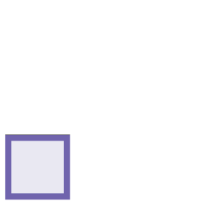

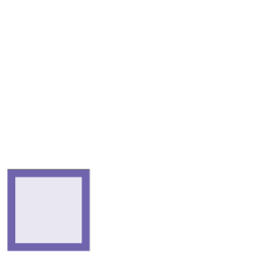










Streaming Data
Entities in a Stream are
grouped into batches

Slide 6
Streaming Data
Each batch = 1 RDD

Slide 7
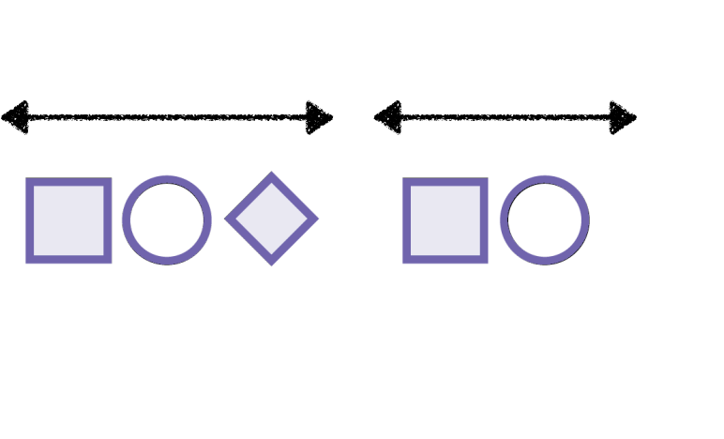




Streaming Data
1 sec
1 sec
1 sec
1 sec
All logs received within the
batch interval make one RDD

Slide 8







Streaming Data
RDD4
RDD3
RDD2
RDD1
Within a DStream, Spark still performs
operations on individual RDDs

Slide 9







Streaming Data
RDD4
RDD3
RDD2
RDD1
RDD4’
RDD3’
RDD2’
RDD1’

Slide 10
Operations on DStream
1. Transformations
Similar to that of RDDs, transformations allow the data from the input DStream to be modified.
Types of Transformations
Stateless transformations
The processing of each batch does not depend on the data of its previous batches. They include the common RDD transformations we like map(), filter(), and reduceByKey().
Stateful transformations
Use data or intermediate results from previous batches to compute the results of the current batch. They include transformations based on sliding windows and on tracking state across time.
Output operations
Output operations allow DStream’s data to be pushed out to external systems like a database or a file systems.
Since the output operations actually allow the transformed data to be consumed by external systems, they trigger the actual execution of all the DStream transformations

Slide 11

Demo
Listen for streaming text data on a host
and port
Demo
Track error messages received using
DStream transformations

Slide 12
Streaming Program(Stateless)
import sys
from pyspark import SparkContext
from pyspark.streaming import StreamingContext
#if threading.current_thread().__class__.__name__ == '_MainThread'
if __name__ == "__main__":
sc = SparkContext(appName="StreamingErrorCount")
ssc = StreamingContext(sc, 10) # 10(seconds) is batch interval which forms an RDD with the data received in that timeframe.
ssc.checkpoint("file:///tmp/spark") #checkpointing used for fault tolerance for streaming process.
lines = ssc.socketTextStream(sys.argv[1], int(sys.argv[2])) # socketTextStream is used to listen data from a soket that is passed from command line, first is host and second is port, here lines is a stream where data will constantly change per batch interval.
counts = lines.flatMap(lambda line: line.split(" "))\
.filter(lambda word:"ERROR" in word)\
.map(lambda word: (word, 1))\
.reduceByKey(lambda a, b: a+b)
counts.pprint()
ssc.start()
ssc.awaitTermination()
Modify the log4j.properties file in spark’s conf directory to WARN.
In one terminal, ncat -l -p 7777
Another terminal,
spark-submit 'code/sparkstreamcode/spark1.py' localhost 7777
This is a stateless transformation which means this transformations or operations are formed on each individual RDDs in batch interval and maintains no memory of previously processed RDDs

Slide 13
Differentiate between stateful and stateless transformations
Apply stateful transformations
across all entities in the stream
on a window of entities in a stream
Implement these transformations using Python
Overview

Slide 14


Stream Transformations
Stateless
Stateful
Transformations which are
applied on a single RDD
Transformations which
accumulate across multiple RDDs

Slide 15

Stateless Transformations
Batch processing from a file
All data available in a single RDD
map(), reduceByKey(), filter()
All transformations used so far have
been stateless

Slide 16

Stateful Transformations
Apply to streaming data
Include data from more than one RDD
Accumulate data across a longer time
interval
- entire stream
- window

Slide 17

Summarizing Data in a Stream

Slide 18



Summarizing Stream Data
4
7
3
8
9
0
1
6
4
3
A stream of integers

Slide 19




Summarizing Stream Data
4
7
3
8
9
0
1
6
4
3
Grouped into batches

Slide 20
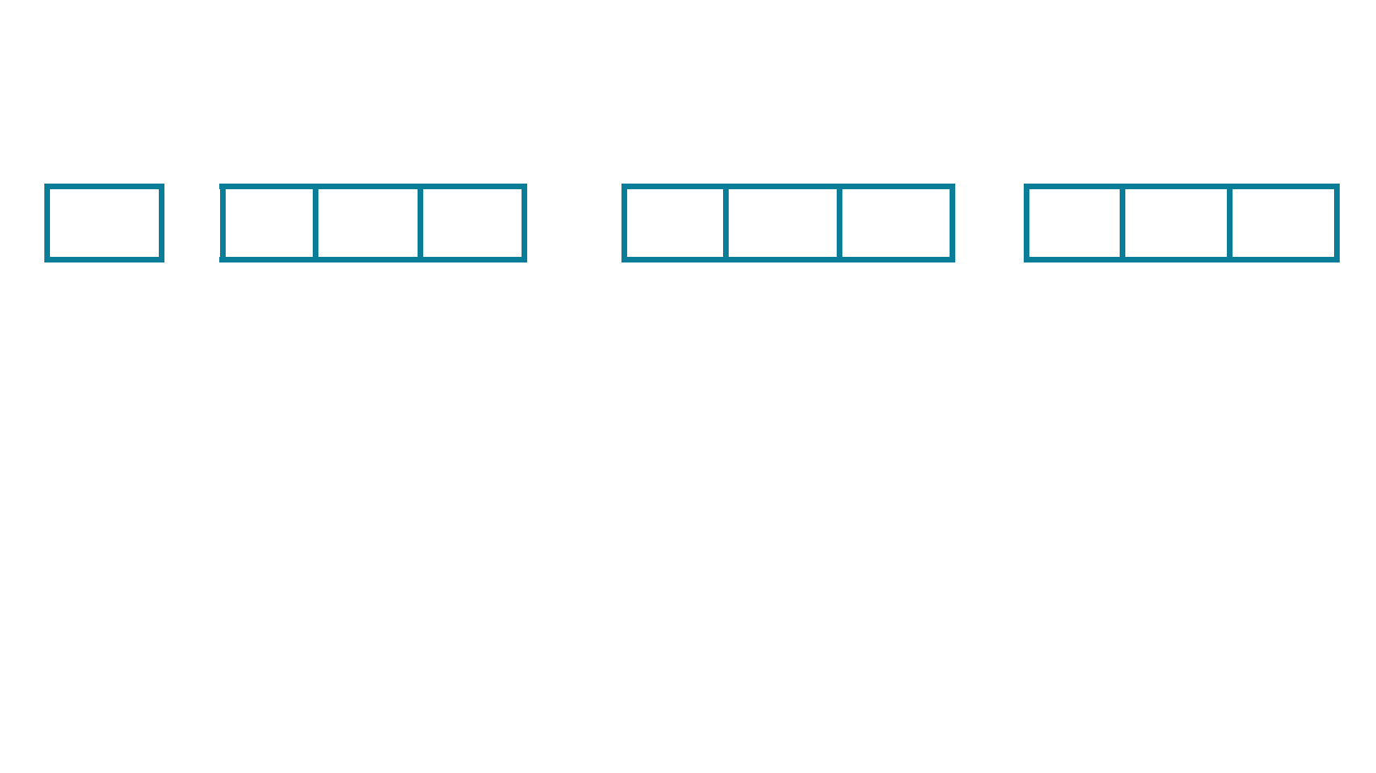
Summarizing Stream Data
RDD4
RDD3
RDD2
RDD1
4
7
3
8
9
0
1
6
4
3
Each group is an RDD
within the DStream

Slide 21
Summarizing Stream Data
RDD4
RDD3
RDD2
RDD1
4
7
3
8
9
0
1
6
4
3
Apply the sum()
operation to the DStream

Slide 22







Summarizing Stream Data
RDD4
RDD3
RDD2
RDD1
4
7
3
8
9
0
1
6
4
3
4
18
10
13
The result is another DStream

Slide 23
Summarizing Stream Data
4
7
3
8
9
0
1
6
4
3
What if you want to keep a
running total of all integers
in the stream?

Slide 24
Stateful Transformations
Stateful transformations are operations on DStreams that track data across time.
Some data from previous batches is used to generate the results for a new batch.
The two main types of Stateful Transformations
Windowed operation
act over a sliding window of time periods
updateStateByKey()
used to track state across events for each key

Slide 25
updateStateByKey on DStream
Pair RDDs have a method called updateStateByKey(updateFn)
This summarizes data across all elements in a stream
The updateStateByKey operation allows you to maintain arbitrary state while continuously updating it with new information. To use this, you will have to do two steps.
Define the state - The state can be an arbitrary data type.
Define the state update function - Specify with a function how to update the state using the previous state and the new values from an input stream.

Slide 26

Pair RDDs
Every element in the dataset is a key-
value pair
Represented as a tuple in Python i.e.
(word, count)
Special transformations apply to pair
RDDs
- keys(), values()
- groupByKey()
- reduceByKey()

Slide 27

Summarizing Stream Data
updateStateByKey(fn)
Apply a summarizing operation on all
values with the same key in a DStream

Slide 28

Pair RDDs
Initialize the state to some value
Specify an update function which
updates the current state based on
the values in the stream
Apply this update function to all
existing keys

Slide 29
Summarizing Stream Data
4
7
3
8
9
0
1
6
4
3
Assign the same key to each integer to
make every element a key-value pair

Slide 30
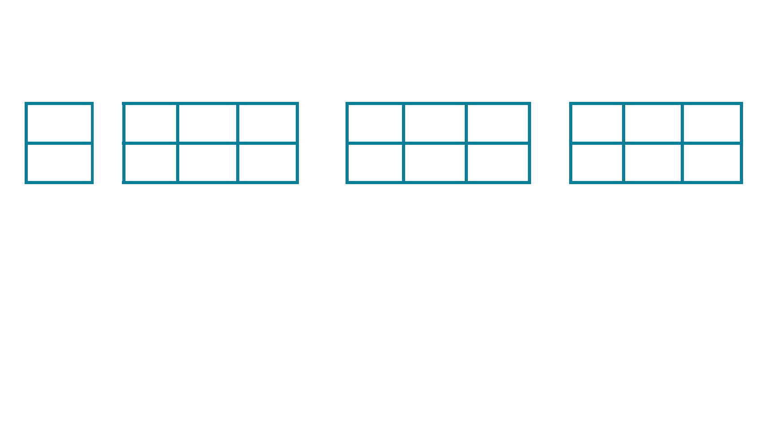
Summarizing Stream Data
4
7
3
8
9
0
1
6
4
3
“K”
“K” “K” “K”
“K” “K” “K”
“K” “K” “K”
The updateStateByKey() will
sum all values with the same key

Slide 31


Summarizing Stream Data
4
7
3
8
9
0
1
6
4
3
“K”
“K” “K” “K”
“K” “K” “K”
“K” “K” “K”
45

Slide 32
Apply updateStateByKey() on a
DStream to count the number of
occurrences of each word in a text
Stream
Demo
Demo
updateStateByKey
It can process all entity of DStream or a particular interval of streams
It works similar to ReduceByKey but works on multiple streams by maintaining the state.

Slide 33
updateStateByKey Demo
import sys
from pyspark import SparkContext
from pyspark.streaming import StreamingContext
if __name__ == "__main__":
sc = SparkContext(appName="StreamingWordCount")
ssc = StreamingContext(sc, 10)
ssc.checkpoint("file:///tmp/spark")
lines = ssc.socketTextStream(sys.argv[1], int(sys.argv[2]))
def countWords(newValues, lastSum):
if lastSum is None:
lastSum = 0
return sum(newValues, lastSum)
word_counts = lines.flatMap(lambda line: line.split(" "))\
.map(lambda word: (word, 1))\
.updateStateByKey(countWords)
word_counts.pprint()
ssc.start()
ssc.awaitTermination()

Slide 34
Window operation
Transformation on DStream over a specified interval is accomplished using window operation.
Used for processing data of multiple batches by maintaining state, This is achieved by defining a sliding window for cumulative summaries by defining window size and sliding interval.
Window size - For e.g., if window size is defined as 30 seconds and batch interval is 10 seconds then It will process 3 RDDs per batch
Sliding interval – This determines how many RDDs will leave the sliding window and how many RDDs will enter the sliding window. For. E.g. for 20 seconds sliding window with 10 seconds batch interval will confirm 2 RDDs leaving the sliding window and 2 are inserted newly.
All RDDs within a sliding window are treated as a single combined RDDs and the operations performed here will apply on all sliding window RDDs as a combined RDD.

Slide 35














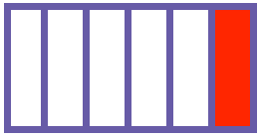
Window Operations
Messages are grouped into
RDDs based on a batchInterval

Slide 36
Window Operations
batchInterval ~ short
duration of time
e.g. 10 seconds

Slide 37
Window Operations
Certain kinds of analysis are
best over longer durations

Slide 38
Window Operations
Cumulative error rate over a
30 second timeframe

Slide 39








Window Operations
Cumulative error rate over a
30 second timeframe

Slide 40
Window Operations
Deﬁne a sliding window
for cumulative summaries

Slide 41


Window Operations
Window size = 30 seconds

Slide 42



Window Operations
Sliding interval = 20 seconds

Slide 43

Window Operations
All RDDs within a window are
treated as a single combined RDD

Slide 44






Window Operations
9
7
5
9
countByWindow()

Slide 45





Window Operations
9
7
5
9
Resultant DStream where the
summary is accumulated per window

Slide 46
Demo
Demo
Count the number of messages in a
window interval

Slide 47
countByWindow Demo
import sys
from pyspark import SparkContext
from pyspark.streaming import StreamingContext
if __name__ == "__main__":
sc = SparkContext(appName="StreamingWindowCount")
ssc = StreamingContext(sc, 2) # it is batch interval
ssc.checkpoint("file:///tmp/spark")
lines = ssc.socketTextStream(sys.argv[1], int(sys.argv[2]))
counts = lines.countByWindow(10, 4) # countByWindow allows to count messages within this timeframe. Where 10 is the time interval for window size and 2 is the sliding interval. In this example, as batch interval is 2 and window interval is 10 then each sliding window will have 5 RDDs(Window interval/batch interval) as combined RDD and overtime leaving 2 RDDs and adds 2 new RDDs as sliding interval is 4 seconds(sliding interval/batch interval)
counts.pprint()
ssc.start()
ssc.awaitTermination()

Slide 48
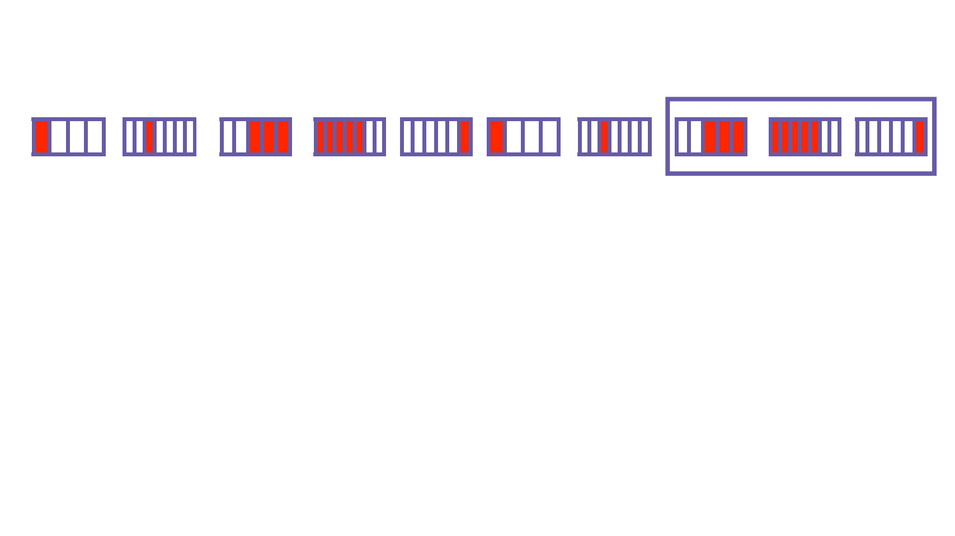

Summary and Inverse Functions
9
The summary function
performs the sum() operation

Slide 49
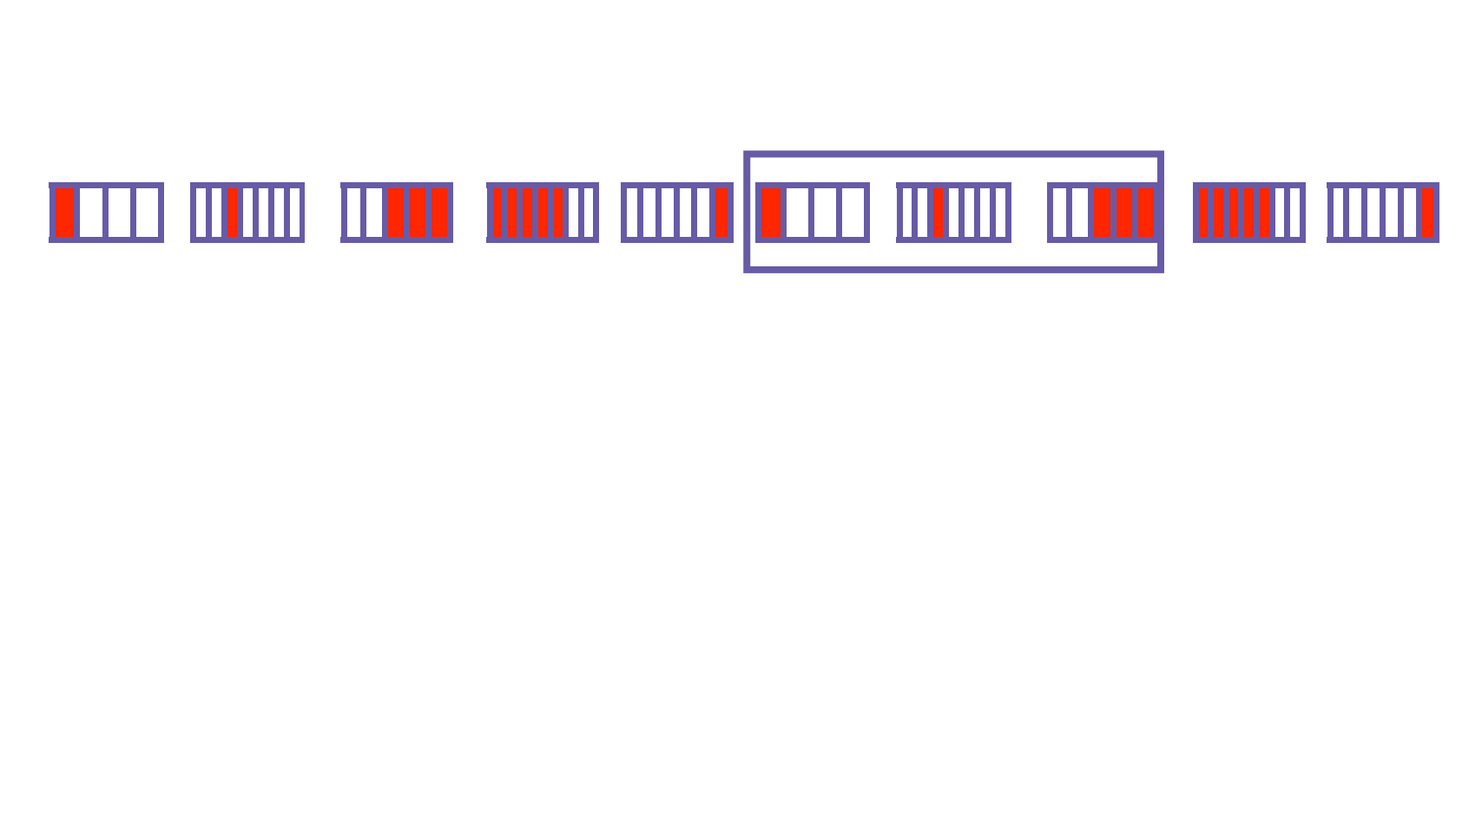

Summary and Inverse Functions
5
9
2 RDDs entered the window
9 + 2 = 11
2 RDDs left the window
11 - 6 = 5

Slide 50
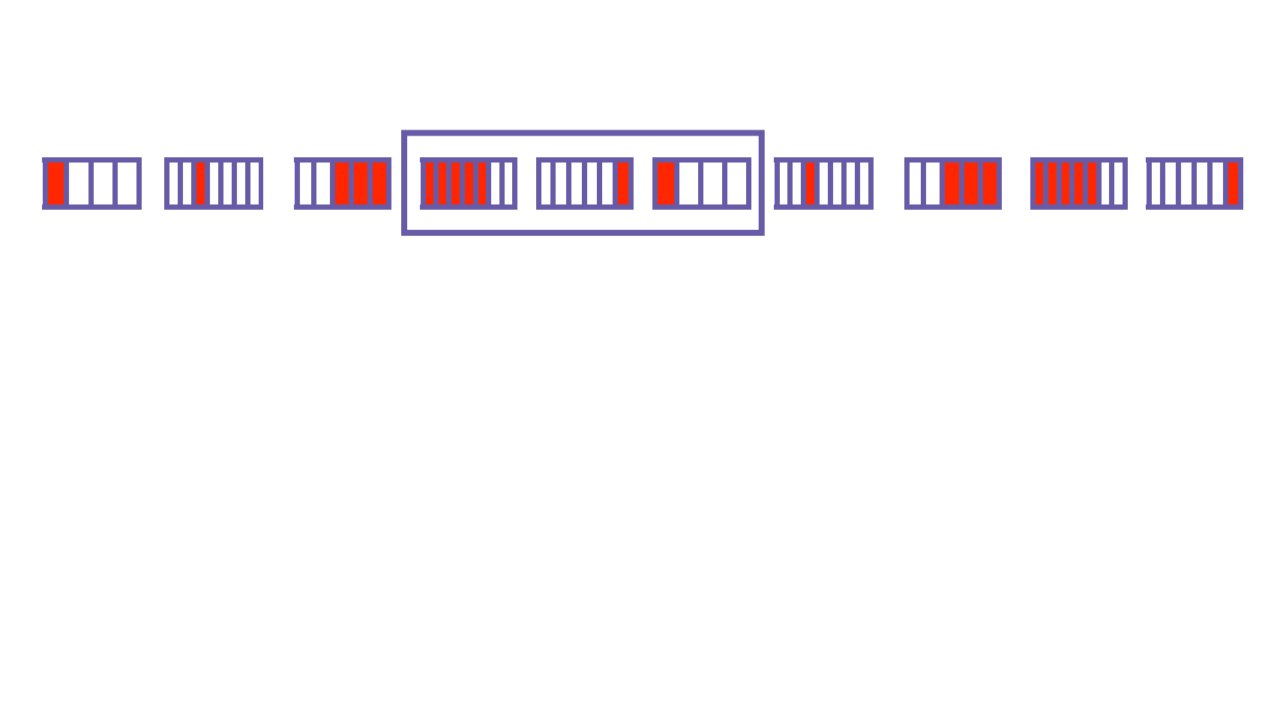

Summary and Inverse Functions
7
5
9
2 RDDs entered the window
5 + 6 = 11
2 RDDs left the window
11 - 4 = 7

Slide 51
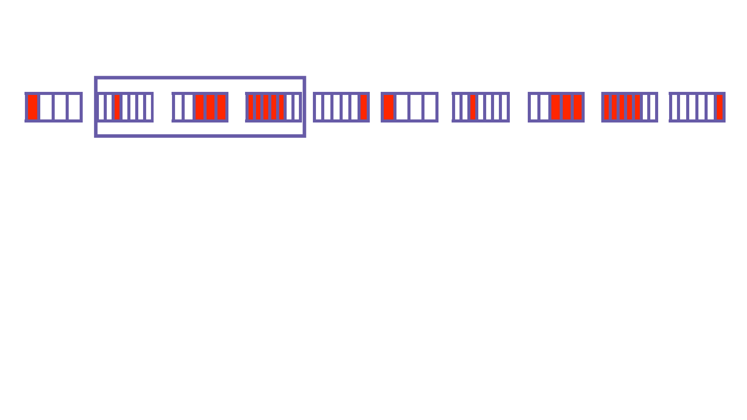

Summary and Inverse Functions
9
7
5
9
2 RDDs entered the window
7 + 4 = 11
2 RDDs left the window
11 - 2 = 9

Slide 52
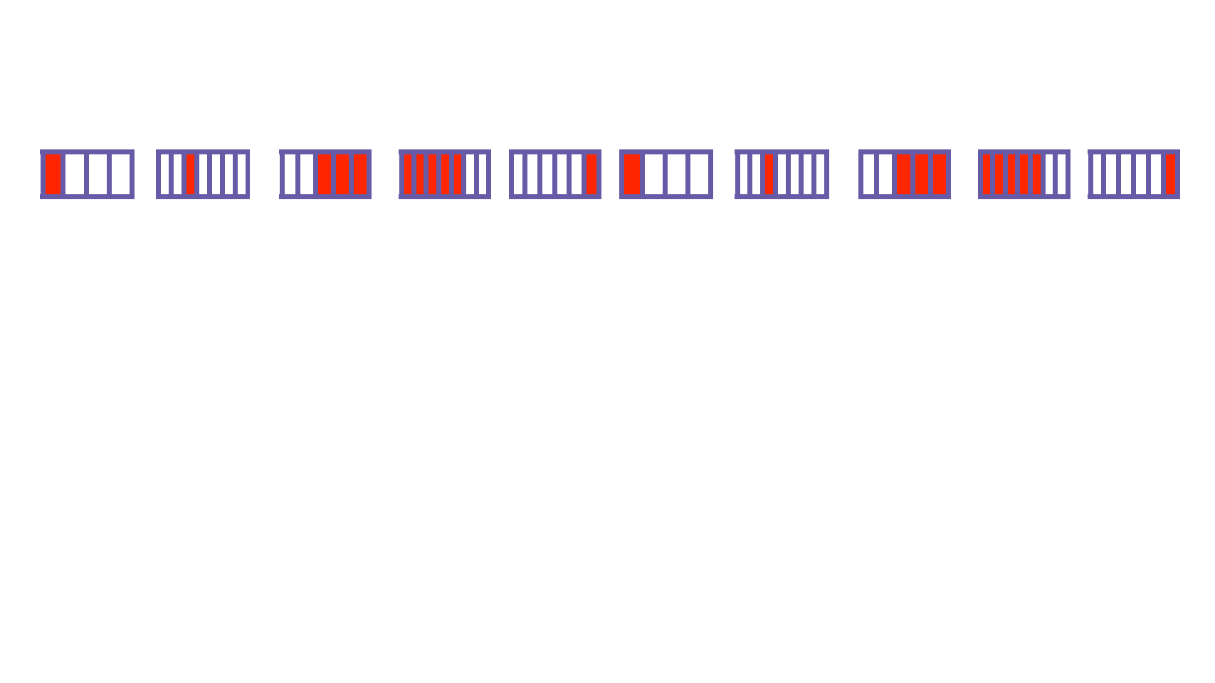
Summary and Inverse Functions
9
7
5
9
2 RDDs entered the window Summary function
2 RDDs left the window
Inverse function

Slide 53
reduceByWindow with Summary and Inverse operation
import sys
from pyspark import SparkContext
from pyspark.streaming import StreamingContext
if __name__ == "__main__":
sc = SparkContext(appName="StreamingWindowSum")
ssc = StreamingContext(sc, 2)
ssc.checkpoint("file:///tmp/spark")
lines = ssc.socketTextStream(sys.argv[1], int(sys.argv[2]))
sum = lines.reduceByWindow(
lambda x, y: int(x) + int(y),
lambda x, y: int(x) - int(y),
10, 2)
#Unlike countByWindow which just counts the messages in DStream, reduceByWindow accepts lambda function for applying different operations like sum, avg etc. that to different operations for Summary and Inverse functions.
#Summary Function, operation applies to the new RDDs that gets added to DStream
#Inverse Function, operation applies to the RDDs that leaves the stream
# 10 is window interval and 2 is sliding interval.
sum.pprint()
ssc.start()
ssc.awaitTermination()

Slide 54
reduceByKeyAndWindow
#Simiar to reduceByWindow but works for key value RDDs.
import sys
from pyspark import SparkContext
from pyspark.streaming import StreamingContext
if __name__ == "__main__":
sc = SparkContext(appName="StreamingErrorCount")
ssc = StreamingContext(sc, 2)
ssc.checkpoint("file:///tmp/spark")
lines = ssc.socketTextStream(sys.argv[1], int(sys.argv[2]))
counts = lines.flatMap(lambda line: line.split(" "))\
.filter(lambda word:"ERROR" in word)\
.map(lambda word: (word, 1))\
.reduceByKeyAndWindow(lambda a, b: a + b, lambda a, b: a - b, 20, 2)
counts.pprint()
ssc.start()
ssc.awaitTermination()

Slide 55
Spark streaming with Kafka Topic
import sys
from pyspark import SparkContext, SparkConf
from pyspark.streaming import StreamingContext
from pyspark.streaming.kafka import KafkaUtils
from uuid import uuid1
if __name__ == "__main__":
sc = SparkContext(appName="StreamingErrorCount")
ssc = StreamingContext(sc, 5)
kvs = KafkaUtils.createStream(ssc, "localhost:2181","raw-event-streaming-consumer",{"mytopic":1})
lines = kvs.map(lambda x: x[1])
counts = lines.flatMap(lambda line: line.split(" ")).map(lambda word: (word, 1)).reduceByKey(lambda a, b: a+b)
counts.pprint()
ssc.start()
ssc.awaitTermination()
spark-submit --packages org.apache.spark:spark-streaming-kafka-0-8-assembly_2.11:2.3.1 code/SparkStreamCode/sparkafka.py
Start ZK - zookeeper-server-start.sh /usr/lib/kafka_2.11-1.1.0/config/zookeeper.properties
Start KAFKA Brokers - kafka-server-start.sh /usr/lib/kafka_2.11-1.1.0/config/server.properties
Start KAFKA Producer - kafka-console-producer.sh --broker-list localhost:9092 --topic mytopic

Slide 56
Checkpointing
A streaming application must operate 24/7 and hence must be resilient to failures unrelated to the application logic. For this to be possible, Spark Streaming needs to checkpoint enough information to a fault- tolerant storage system such that it can recover from failures.
There are two types of data that are checkpointed.
Metadata checkpointing - Used to recover from failure of the node running the driver of the streaming application. Metadata includes Configuration, DStream operations, Incomplete batches.
Data checkpointing - Saving of the generated RDDs to reliable storage. This is necessary in some stateful transformations that combine data across multiple batches.
To summarize, metadata checkpointing is primarily needed for recovery from driver failures, whereas data or RDD checkpointing is necessary even for basic functioning if stateful transformations are used.

Slide 57
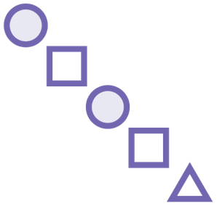


Checkpointing
Fault tolerance
Periodically save data to a reliable storage system
Limiting state re-computation in case of failure
Fault tolerance for driver jobs

Slide 58
Configure Checkpointing
Checkpointing can be enabled by setting a directory in a fault-tolerant, reliable file system (e.g., HDFS, S3, etc.)
Done by using streamingContext.checkpoint(checkpointDirectory).
When the program is being started for the first time, it will create a new StreamingContext, set up all the streams and then call start().
When the program is being restarted after failure, it will re-create a StreamingContext from the checkpoint data in the checkpoint directory.
# Function to create and setup a new StreamingContext
def functionToCreateContext():
sc = SparkContext(...) # new context
ssc = StreamingContext(...)
lines = ssc.socketTextStream(...) # create DStreams
...
ssc.checkpoint(checkpointDirectory) # set checkpoint directory
return ssc
# Get StreamingContext from checkpoint data or create a new one
context = StreamingContext.getOrCreate(checkpointDirectory, functionToCreateContext)

Slide 59
Structured Streaming in Spark 2.x
Structured Streaming is a scalable and fault-tolerant stream processing engine built on the Spark SQL engine.
Bounded datasets are processed in batches and Unbounded datasets are processed as streams.
Structured Streaming treats a live data stream as a table that is being continuously appended
Burden of stream-processing shifts from user to system

Slide 60
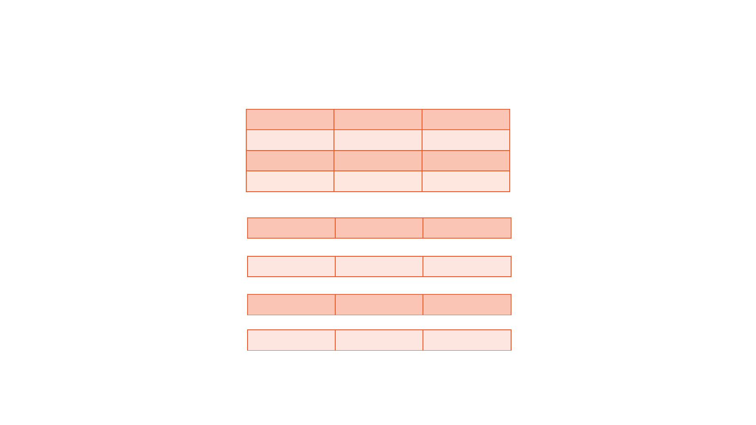

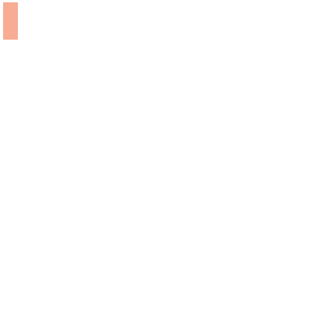



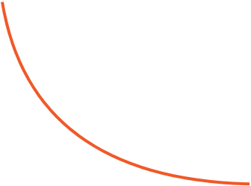
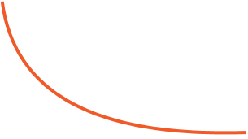

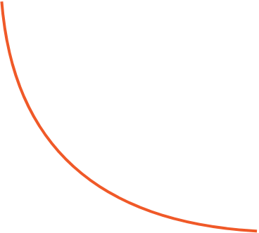
Batch is Simply Prefix of Stream
Data stream
Unbounded Table
Every data item
that is arriving on
the stream is like a
new row being
appended to the
input table
Data stream as an unbounded input Table

Slide 61
Batch is Simply Prefix of Stream
Data stream
Unbounded Table
All operations
that can be
performed on
data frames can
be performed
on the stream
Data stream as an unbounded input Table

Slide 62


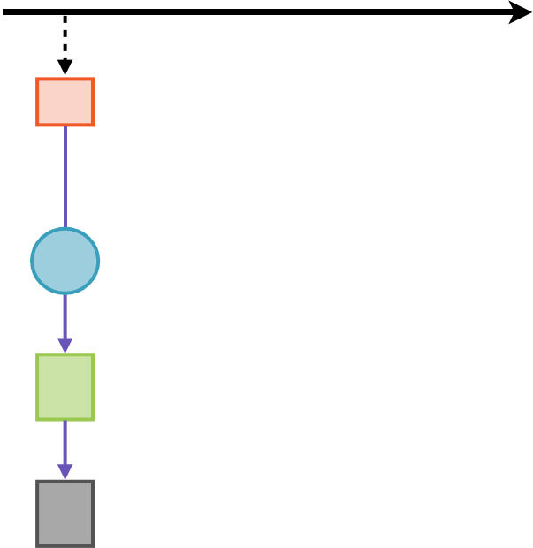










Result Table Is Generated
Triggers
1
2
3
System
Time
Input
Table
Input
Table
data up
to t = 1
data up
to t = 2
data up
to t = 3
Incremental
Query
User
Query
Spark SQL
Planner
Result
Table
Result
Table
result up
to t = 1
result up
to t = 2
result up
to t = 3
Output
Update Mode
rows
updated
at t = 2
rows
updated
at t = 3
User’s batch-like
query on input table
Incremental execution on streaming data

Slide 63


Materialization
Structured streaming reads data from
source
-
Processes incrementally
Data Sink
-
Updates result
-
Discards source
Only minimal intermediate state
maintained

Slide 64
Output Modes
Complete Mode - The entire updated Result Table will be written to the external storage. It is up to the storage connector to decide how to handle writing of the entire table.
Append Mode - Only the new rows appended in the Result Table since the last trigger will be written to the external storage. This is applicable only on the queries where existing rows in the Result Table are not expected to change.
Update Mode - Only the rows that were updated in the Result Table since the last trigger will be written to the external storage (available since Spark 2.1.1). Note that this is different from the Complete Mode in that this mode only outputs the rows that have changed since the last trigger. If the query doesn’t contain aggregations, it will be equivalent to Append mode.

Slide 65
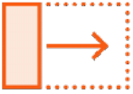
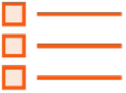

Output Modes
Update mode - only Result Table rows updated since last trigger
Even previous results will be updated in case of aggregations
Append mode - only Result Table rows appended since last trigger
Previous (existing) output rows cannot change
Complete mode - entire updated Result Table is sent across
Storage connector must decide how to use all that data

Slide 66

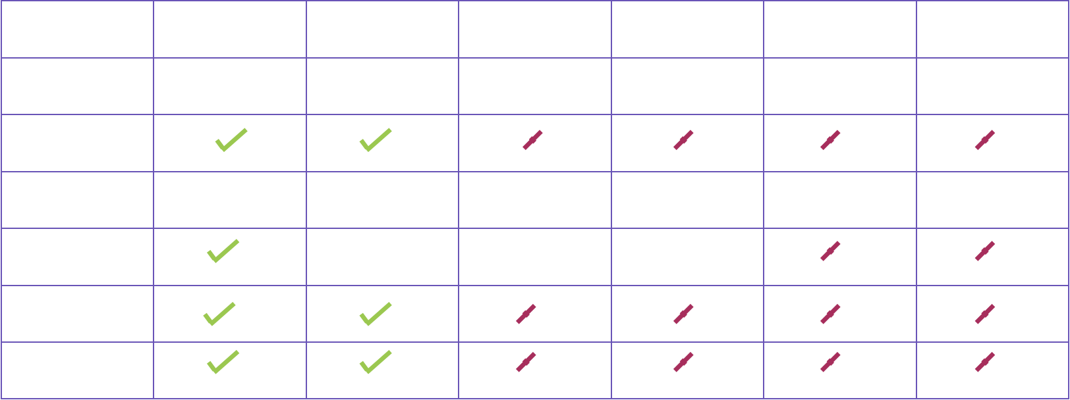
Comparison with Other Engines
Property
Structured
Spark
Apache
Apache
Kafka
Google
Streaming
Streaming
Storm
Flink
Streams
Dataﬂow
Streaming API
incrementalize
batch queries
integrates
with batch
separate
from batch
separate
from batch
separate
from batch
integrates
with batch
Preﬁx Integrity
Guarantee
Internal
Processing
exactly once
exactly once
at least once
exactly once
at least once
exactly once
Transactional
Sources/Sinks
some
some
some
Interactive
Queries
Joins with
Static Data

Slide 67

Demo
Demo
A simple structured streaming application

Slide 68
Structured Streaming - Demo
netcat
Start ncat using command , ncat -l -p 7777
Run the netcat.py programs by passing the localhost 7777 parameters.
Output Modes
Create the droplocation as mentioned in the code using command
mkdir –p /home/notroot/datasets/droplocation
Run the respective program using spark-submit without any parameters.
3 input files are provided (xaa.csv, xaa_updatemode.csv, xab.csv). Copy files to droplocation one by one and observe the output of the program.
Append mode (appendMode.py):
New records will get added incrementally in each batch without impacting previous batch data.
Complete mode(completeMode.py):
Counts of the crime will get updated and complete output will be shown in each batch as processing will consider whole data.
Update mode(updateMode.py):
Only the impacted records will be displayed instead of the entire dataset.

